Slide 1
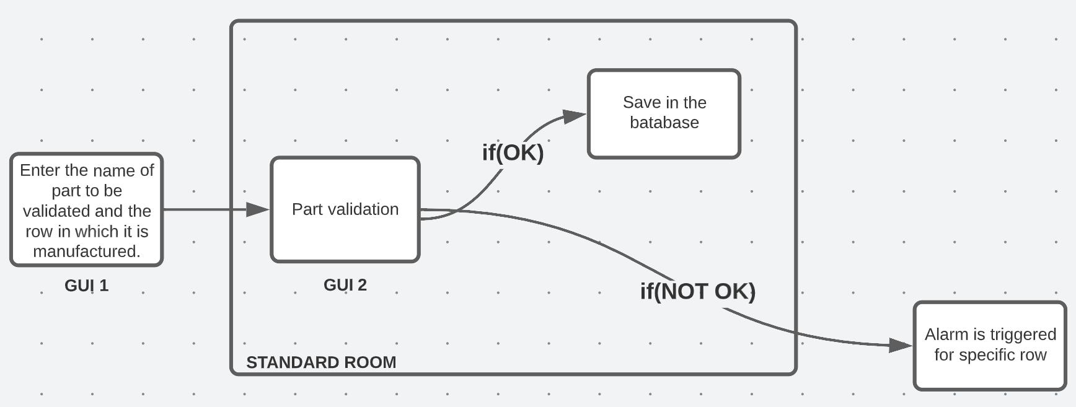
Title: NEW GUI (UX) SYSTEM TO GIVE FEEDBACK TO THE MACHINE REGARDING THE FIRST PIECE INSPECTION IN STANDARD ROOM
DANA
Problem Statement:
Currently do not have any system to give feedback to the machine operator or Team leader about the first piece inspection in STANDARD ROOM.
Currently using WhatsApp group to communicate the failure which is causing the delay.
No machine interlock with CMM Output.
Currently using a register to write the information regarding the part entering to CMM.
Timeline
Kick-off: 15 Jan’23
Milestone 1: 30 Jan‘23
Milestone 2: 25 Feb‘23
Milestone 3: 30 Mar23
Milestone 4: 15 May‘23
Understanding the requirement and giving the inputs to KLE & US Technology Supplier.
Will have a brief discussion with both teams and give the inputs required to them.
We will ask the team to make a proto to test and study.
Having the fully detailed UX
System and giving the PR & PO.
Implementation of system and sustenance.
KPI’s/ Expectations:
New Embedded system with UI to Part input and output from Standard room.
Part entry and record store in the Digital way rather than register.
Entered record should come in the System inside the STANDARD ROOM
After the inspection if the part is OK or NOT OK alert should be given to Line for the machine stoppage.
If possible direct communication to the machine is required
Alert should be given to TL (Team leader as well as Group leader) in the form of SMS or Mail
Prerequisites:
Basics of Web development.
Understanding the complete project before implementation
React JS for the user interface.
Mongo DB for data storage.
Reference Material:
Getting Started – React (reactjs.org)
MongoDB Atlas: Cloud Document Database | MongoDB

